Slide 1
CRPYTOGRAPHY
Keinan Balsam & Dillon Monday

Slide 2
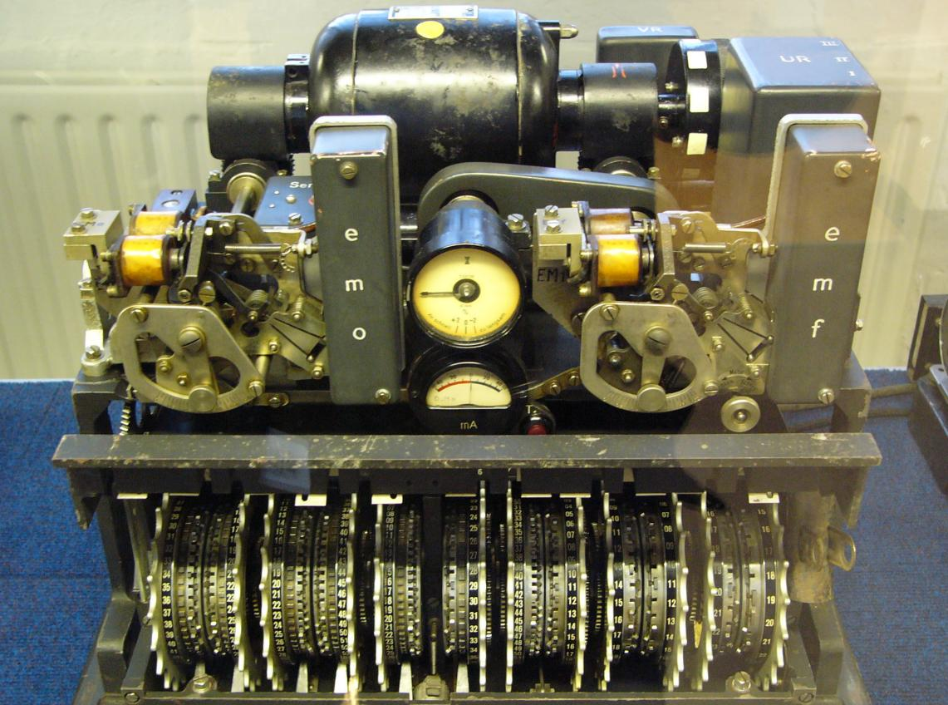
WHAT IS IT Exactly?
Writing or solving codes
Origin is Greek:
Kryptós- meaning “hidden or secret”
Graphein- meaning “writing”
Literally – “hidden or secret writing”

Slide 3
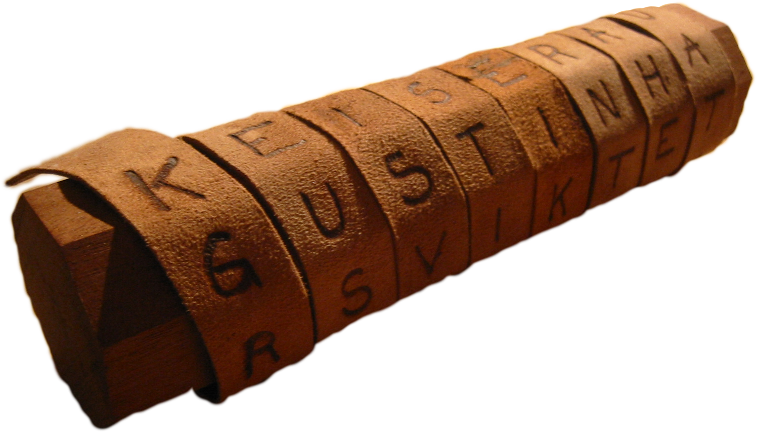
Its old
The oldest form of cryptography is simply the writing out of a message
Times of poor literacy
Greeks had the idea to wrap a tape around a stick and write the message across it.
When unwound the text would be meaningless
Receiver had stick of same diameter

Slide 4
ciphers
A cipher is an algorithm (process or method) used to encrypt or encipher.
Classical Ciphers
Monoalphabetic- the shifting of letters to rearrange an alphabet for a message
Polyalphabetic- the same as monoalphabetic but the cipher would change mid-cipher
Transposition- shifting the existing plaintext around to create a permutation of the current plaintext.

Slide 5
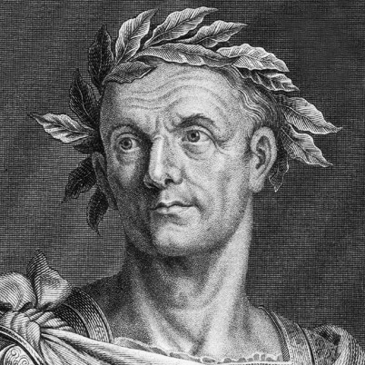
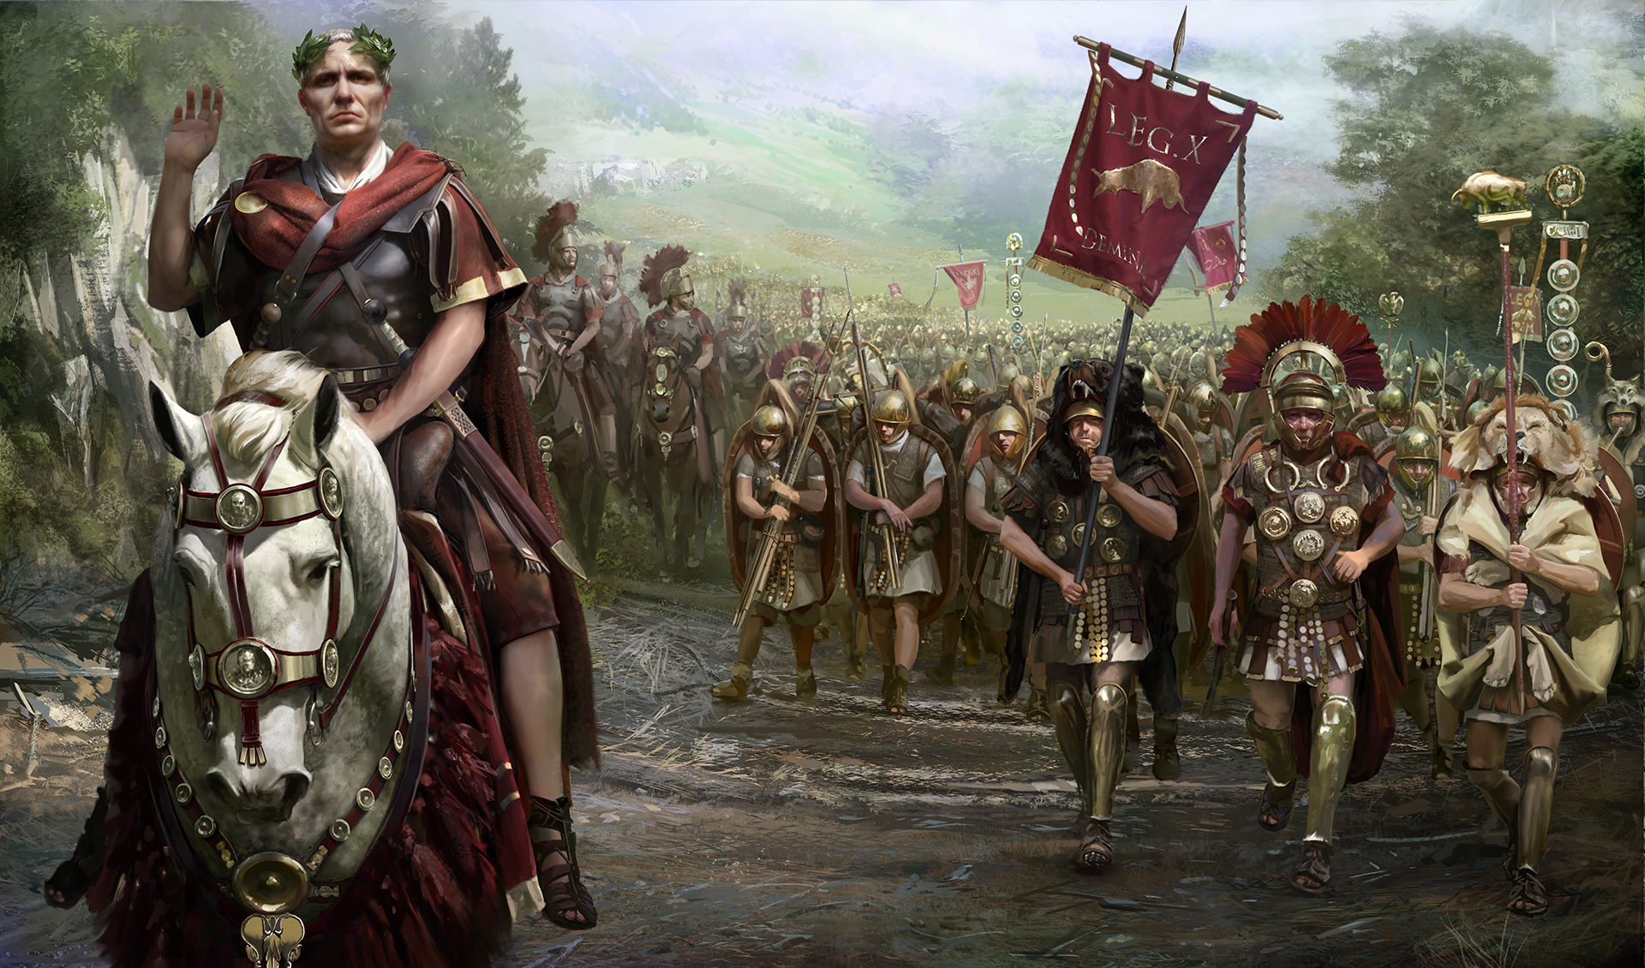
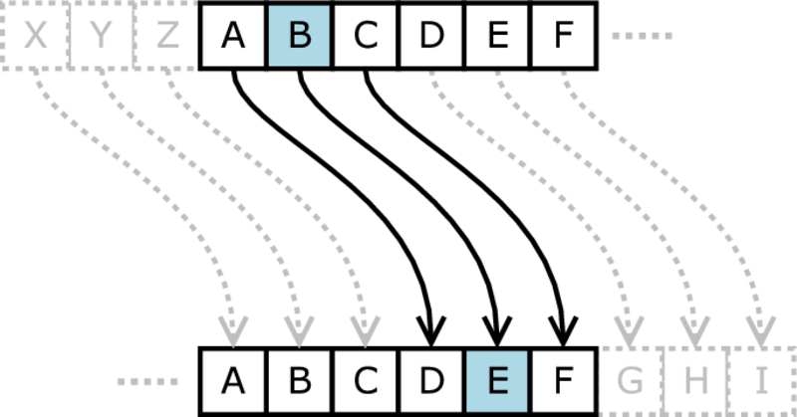
Caesar cipher -Monoalphabetic
One of the first ciphers was very simple
Despite being easy to crack, it remained in use for a long time
Preformed by shifting the letters based on a number or code word.
Julius Caesar used a shift of three.
Could also use a keyword to pull those letters from their sequential position and place them at the beginning
The vigenere cipher is a more complex form of the Caesar cipher.
Uses several Caesar ciphers in correspondence with a keyword

Slide 6
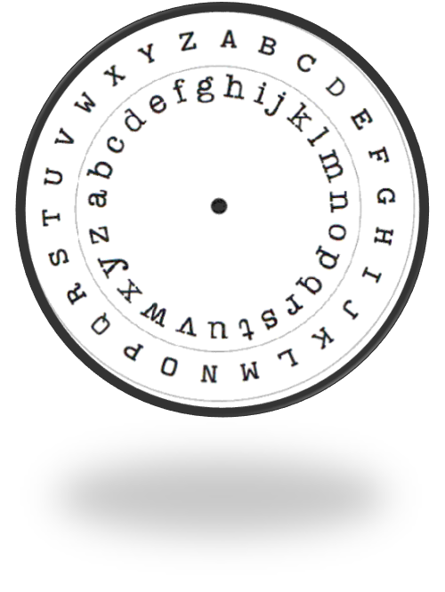
Alberti Cipher - Polyalphabetic
Alberti was known as “The Father of Western Cryptology”
Wrote the alphabet on two free spinning disks
Shifted the inner disk a decided amount every so many words or letters
Effectiveness of frequency analysis limited
Used from 1466 all the way up to the civil war

Slide 7
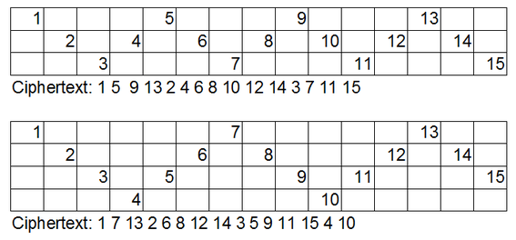
Rail fence cipher -Transposition
Write each letter (or number) in a new column going down one row. When you reach the bottom, go back up.
The cipher text is taken from each row (top down)
This is a good example of a transposition cipher
Ealisy broken by hand due to small number of “rails”

Slide 8
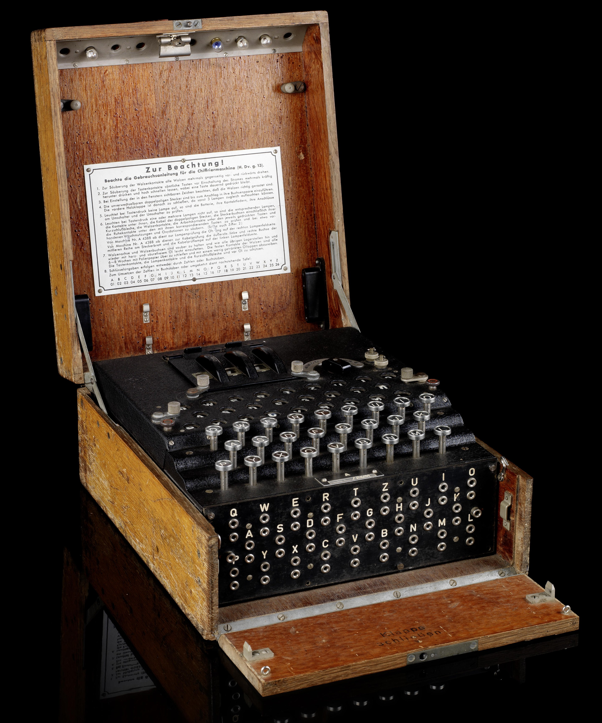
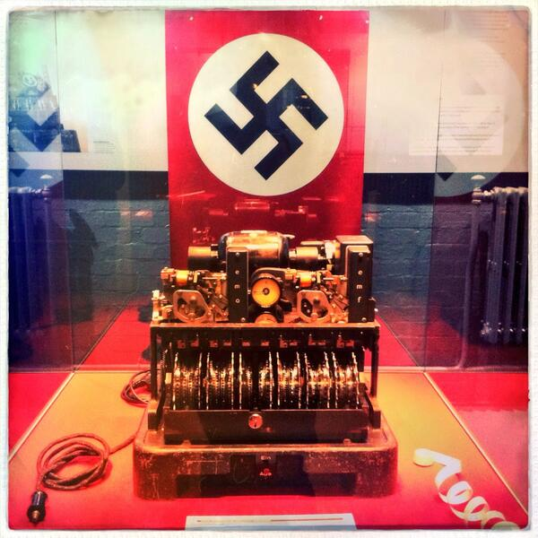
Entering the machine age
World War II gave rise to some interesting
mechanical ciphers including the Lorenz cipher (right)
And the enigma machine
Most of theses were called
Rotor machines, as they created
Polyalphabetic ciphers

Slide 9
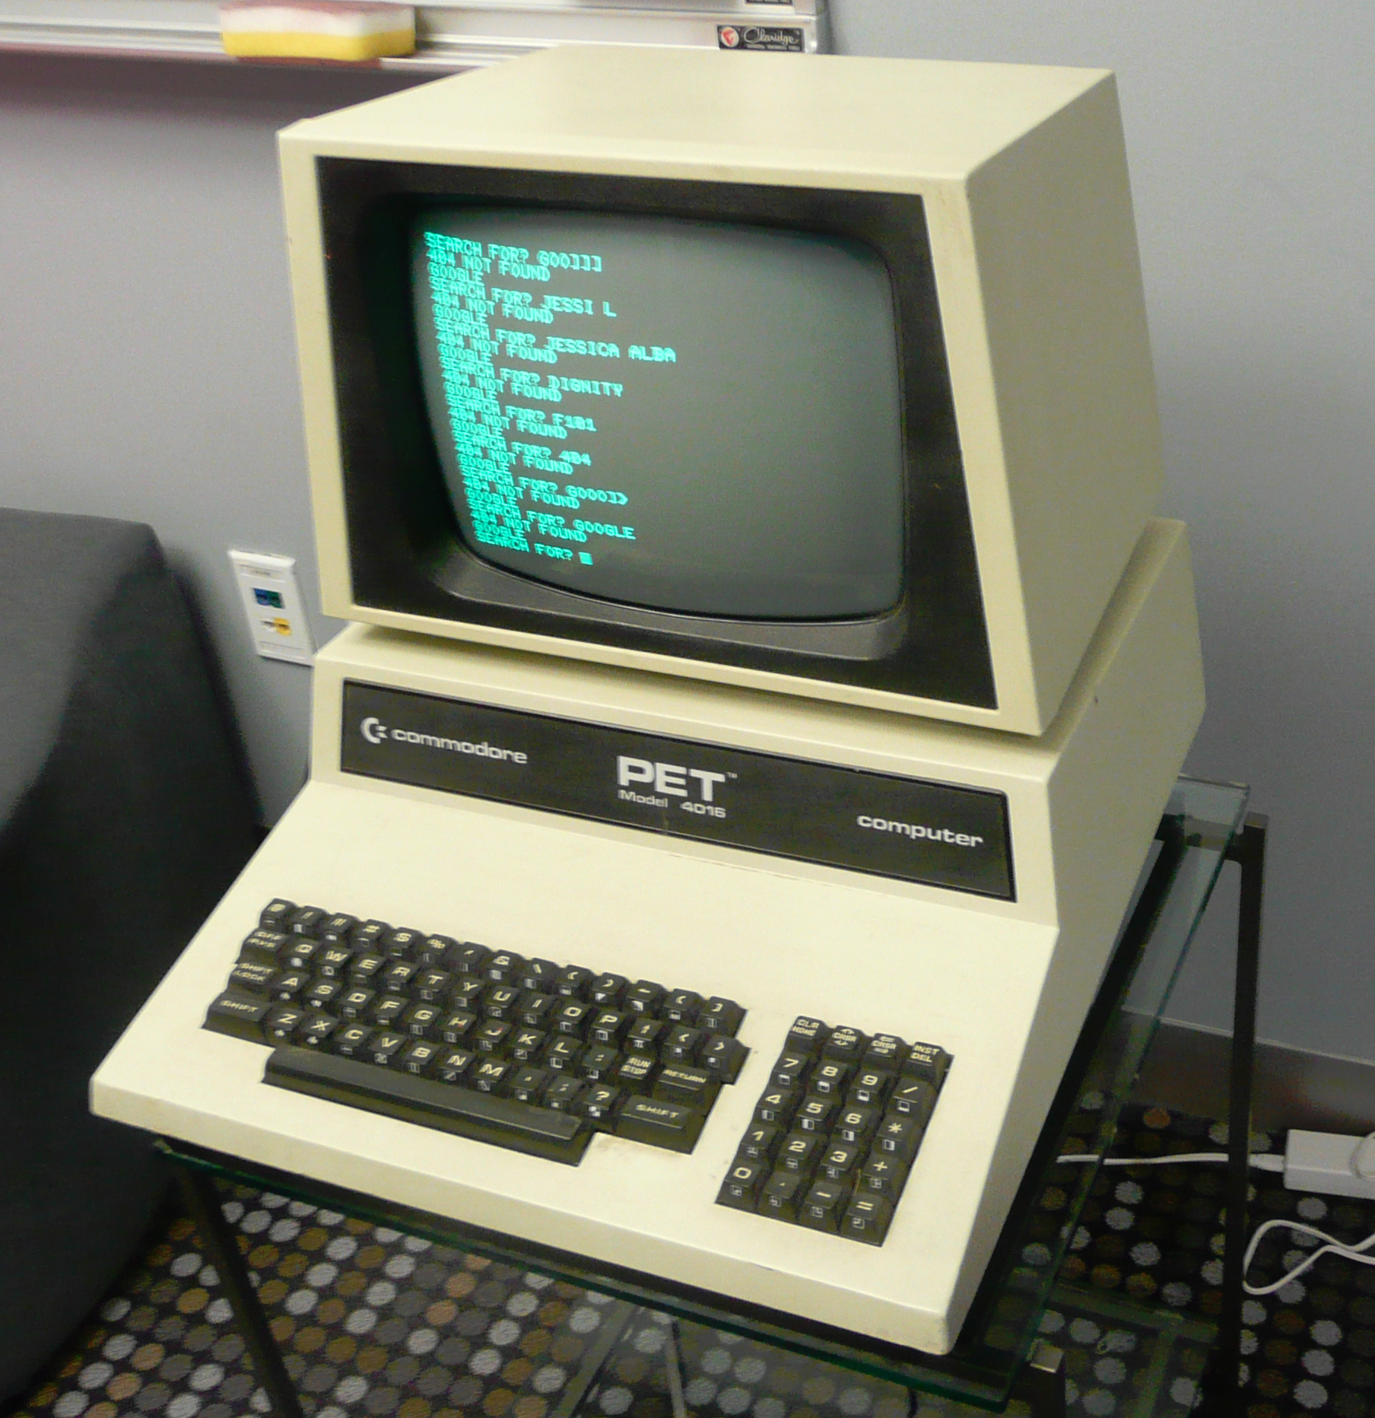
Modern ciphers
The advent of computers created both the necessity and means for increasingly complex methods of encryption.
There are two main methods of computer encryption
Symmetric and asymmetric key algorithms

Slide 10
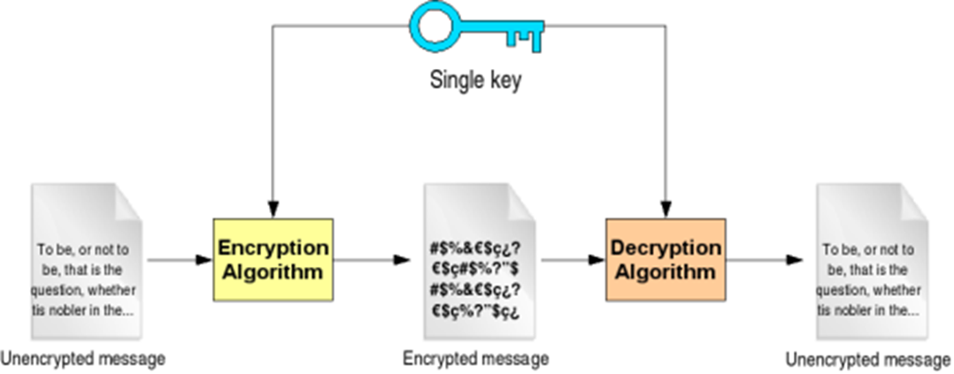
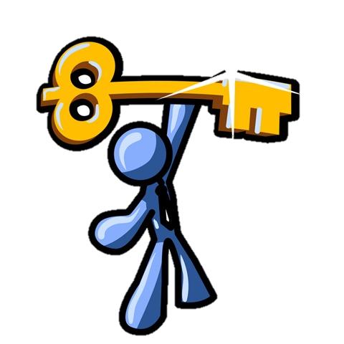
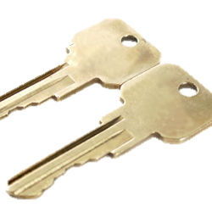
Symmetric key algorithms
The key to encrypt and decrypt are the same.
The disadvantage is that everyone involved needs a key which creates problems in distribution and keeping the keys secret
You can’t send an encrypted key and expect the receiver to understand
You can’t send an unencrypted key and risk exposing future transfer

Slide 11
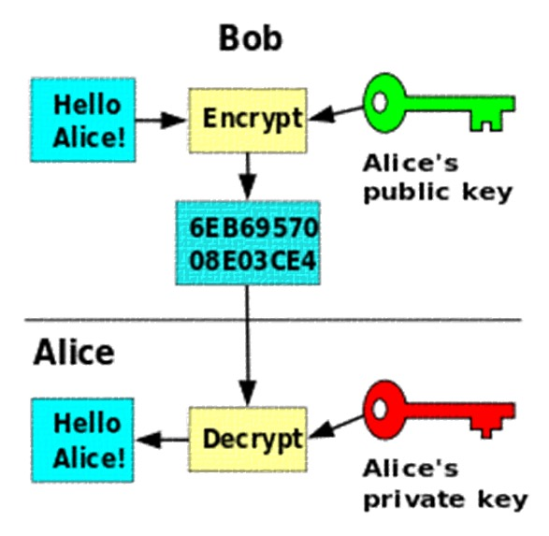
Asymmetric key cryptography
Instead of one key for both, like the private key algorithms, there are separate keys for encryption and decryption

Slide 12
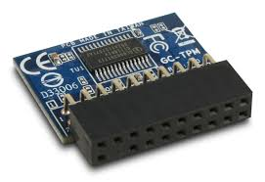
Trusted platform Module (TPM)
Secures hardware by integrating cryptographic keys
Encrypts using cryptographic hash functions which are almost impossible to invert
Uses include disk encryption, password protection and platform intergrity

Slide 13
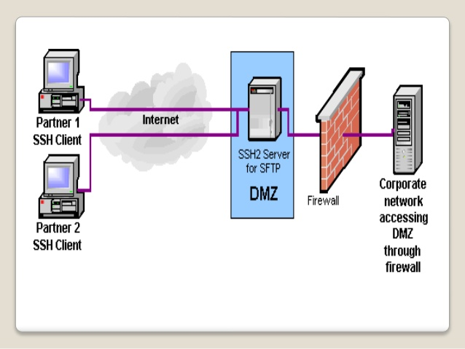
Secure Shell (ssh)
Network protocol allowing for remote login
Provides a secure channel over unsecured networks
Used to log into remote servers and execute commands

Slide 14
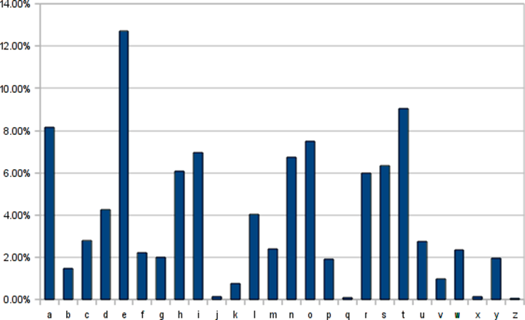
Frequency analysis
There is a specific frequency of use for each character in the English language
Code breakers have used this to their advantage (looking at distributions and guessing at the encryption alphabet)
Works best for long messages and Monoalphabetic encryptions
First found by Arabic mathematician Abu al-Kindi

Slide 15
sources
http://ciphermachines.com/types.html#mono
http://www.richkni.co.uk/php/crypta/freq.php
http://www.stealthcopter.com/blog/2010/01/python-cryptography-decoding-a-caesar-shift-frequency-analysis/

